Slide 1
PowerShell DSC
(Desired State Configuration) from the Trenches

Slide 2

Get-Help –Name ‘about_Presenter’
Mike F Robbins
Microsoft MVP on Windows PowerShell
SAPIEN Technologies MVP
Leader & Co-Founder of Mississippi PowerShell User Group
Co-Author of Windows PowerShell TFM 4th Edition
Author of Chapter 6 in the PowerShell Deep Dives book
Winner of the Advanced Category in the 2013 Scripting Games
Learn more about me @ mikefrobbins.com

Slide 3
Write-Output ‘Questions for Audience’
IT Pro’s
Developers
Database Administrators
PowerShell
PowerShell version 4 or higher
Functions
Modules
Desired State Configuration
PKI (Public Key Infrastructure)

Slide 4
Set-Content ‘Information to Cover’
Requirements
Imperative versus Declarative Configuration
Idempotent
Basics
MOF
LCM
Push
Pull
Resources

Slide 5
Requirements
PowerShell version 4
KB2883200
WinRM Service
WinRM Listeners (Endpoints)
Script Execution Policy –le Remote Signed
KB3000850 (Recommended)
PowerShell Remoting –not Required

Slide 6


Imperative
Describing an item in terms of specific instructions which changes its state.

Slide 7

Declarative
Describe what you’re trying to achieve without instructing how to perform the specific actions to achieve the state.

Slide 8
Idempotent
Desired state is reached regardless of current state.
Current state is irrelevant.
Produces the same results if executed once or multiple times.
Can be repeated or retried as often as necessary without causing unintended effects.
Non-idempotent operations may need to keep track of whether or not the operation was already performed and what the current state is.

Slide 9

Start-Process ‘Demo’
Demo Code: github.com/mikefrobbins/Presentations

Slide 10

Select-Object –Property ‘Resources’
PowerShell.org
Microsoft Virtual Academy
PowerShell Virtual Chapter of SQL PASS
PowerShell Magazine
GitHub
User Groups
Blogs
Twitter
Windows Desired State Configuration Revealed book
Learning PowerShell DSC book

Slide 11

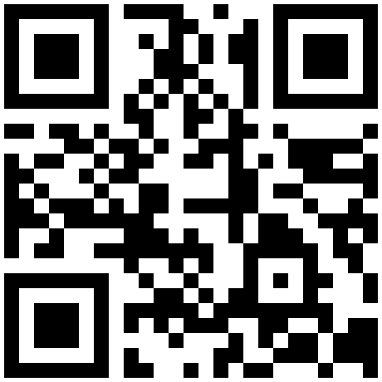

Get-Contact –Identity ‘Presenter’
Blog: mikefrobbins.com (or MrPowerShell.com)
Twitter: @mikefrobbins
LinkedIn: www.linkedin.com/in/mikefrobbins
E-Mail: See mikefrobbins.com/about/
User Group: mspsug.com (or MsPowerShell.com)

